Slide 1
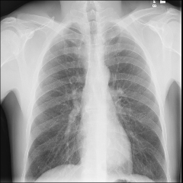
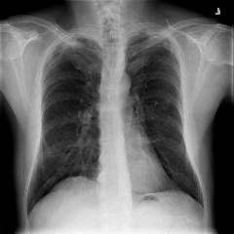
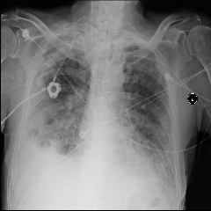
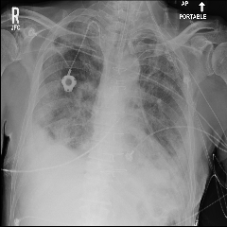
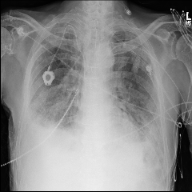
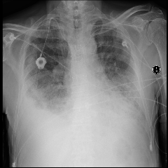
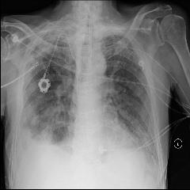
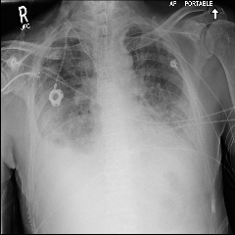
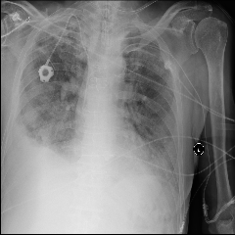
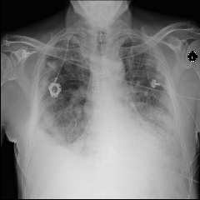
CheXNet
Radiologist-Level Pneumonia Detection on Chest X-Rays with Deep Learning
Joseph Bae
April 6, 2022

Slide 2
Schedule
Overview of CheXNet
Deep Learning Demo
Discussion

Slide 3
Schedule
Overview of CheXNet
Deep Learning Demo
Discussion

Slide 4
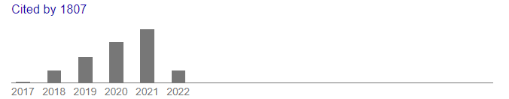
Background
Authors: Pranav Rajpurkar, Jeremy Irvin, Kaylie Zhu, Brandon Yang, Hershel Mehta, Tony Duan, Daisy Ding, Aarti Bagul, Curtis Langlotz, Katie Shpanskaya, Matthew P. Lungren, Andrew Y. Ng
arXiv pre-print

Slide 5
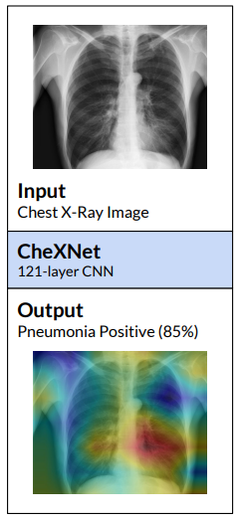
CheXNet – Big Picture
Goal: Develop an AI model to detect pneumonia from chest x-rays (CXR).
Method: Input 100,000 CXRs from a recently released dataset¹ into a fancy new Deep Learning (DL) model².
Result: Putting unseen CXRs into our trained DL model gets us highly accurate predictions for pneumonia detection.
Wang, X. et al. (2017). Chestx-ray8: Hospital-scale chest x-ray database and benchmarks on weakly-supervised classification and localization of common thorax diseases. In CVPR.
Huang, G. et al. (2017). Densely connected convolutional networks. In CVPR.

Slide 6
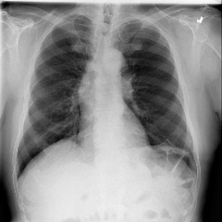
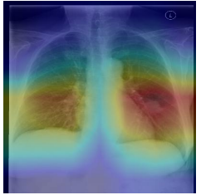
Workflow
Data
Deep Learning
Results/Implications

Slide 7
Workflow
Data
Deep Learning
Results/Implications

Slide 8
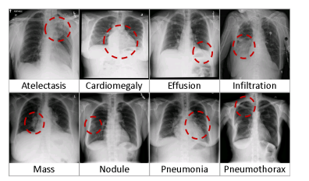
Dataset: ChestX-Ray14
Published by the NIH in the Conference on Computer Vision and Pattern Recognition (CVPR) 2017.
Contains 112,120 frontal CXRs representing 14 pathologies.
Labels for CXRs were automatically generated from radiology reports.
This is an example of “loose” labelling.
Wang, X. et al. (2017). Chestx-ray8: Hospital-scale chest x-ray database and benchmarks on weakly-supervised classification and localization of common thorax diseases. In CVPR.

Slide 9
Dataset: ChestX-Ray14
Published by the NIH in the Conference on Computer Vision and Pattern Recognition (CVPR) 2017.
Contains 112,120 frontal CXRs representing 14 pathologies.
Labels for CXRs were automatically generated from radiology reports.
This is an example of “loose” labelling.
Wang, X. et al. (2017). Chestx-ray8: Hospital-scale chest x-ray database and benchmarks on weakly-supervised classification and localization of common thorax diseases. In CVPR.

Slide 10
Dataset: ChestX-Ray14
Published by the NIH in the Conference on Computer Vision and Pattern Recognition (CVPR) 2017.
Contains 112,120 frontal CXRs representing 14 pathologies.
No lateral views included
Labels for CXRs were automatically generated from radiology reports.
This is an example of “loose” labelling.
Wang, X. et al. (2017). Chestx-ray8: Hospital-scale chest x-ray database and benchmarks on weakly-supervised classification and localization of common thorax diseases. In CVPR.

Slide 11
Dataset: ChestX-Ray14
Published by the NIH in the Conference on Computer Vision and Pattern Recognition (CVPR) 2017.
Contains 112,120 frontal CXRs representing 14 pathologies.
Labels for CXRs were automatically generated from radiology reports.
This is an example of “loose” labelling.
Wang, X. et al. (2017). Chestx-ray8: Hospital-scale chest x-ray database and benchmarks on weakly-supervised classification and localization of common thorax diseases. In CVPR.

Slide 12
Dataset: ChestX-Ray14
Published by the NIH in the Conference on Computer Vision and Pattern Recognition (CVPR) 2017.
Contains 112,120 frontal CXRs representing 14 pathologies.
Labels for CXRs were automatically generated from radiology reports.
This is an example of “loose” labelling.
Four radiologists were recruited to validate labels on the test set.
Wang, X. et al. (2017). Chestx-ray8: Hospital-scale chest x-ray database and benchmarks on weakly-supervised classification and localization of common thorax diseases. In CVPR.

Slide 13
Workflow
Data
Deep Learning
Results/Implications

Slide 14
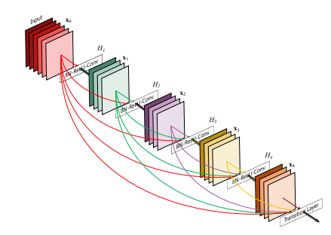
Deep Learning – AI Model
The authors employ DenseNet-121.
Convolutional network with 121 layers.
Huang, G. et al. (2017). Densely connected convolutional networks. In CVPR.

Slide 15
Deep Learning – AI Model
The authors employ DenseNet-121.
Convolutional network with 121 layers.
Image
Huang, G. et al. (2017). Densely connected convolutional networks. In CVPR.

Slide 16
Deep Learning – AI Model
The authors employ DenseNet-121.
Convolutional network with 121 layers.
Convolutional Filter
0 | -1 | 0
-1 | 5 | -1
0 | -1 | 0
Image
Huang, G. et al. (2017). Densely connected convolutional networks. In CVPR.

Slide 17
Deep Learning – AI Model
The authors employ DenseNet-121.
Convolutional network with 121 layers.
Convolutional Filter
0 | -1 | 0
-1 | 5 | -1
0 | -1 | 0
Image
Feature
Huang, G. et al. (2017). Densely connected convolutional networks. In CVPR.

Slide 18
Deep Learning – AI Model
The authors employ DenseNet-121.
Convolutional network with 121 layers.
Feature
Huang, G. et al. (2017). Densely connected convolutional networks. In CVPR.

Slide 19
Deep Learning – AI Model
The authors employ DenseNet-121.
Convolutional network with 121 layers.
Convolutional Filter
1 | 0 | -1
2 | 0 | -2
1 | 0 | -1
Feature
Huang, G. et al. (2017). Densely connected convolutional networks. In CVPR.

Slide 20
Deep Learning – AI Model
The authors employ DenseNet-121.
Convolutional network with 121 layers.
Convolutional Filter
1 | 0 | -1
2 | 0 | -2
1 | 0 | -1
Feature
Feature
Huang, G. et al. (2017). Densely connected convolutional networks. In CVPR.

Slide 21
Deep Learning – AI Model
Image
Convolution
Feature
Feature
Feature
Feature
Feature
Prediction
Huang, G. et al. (2017). Densely connected convolutional networks. In CVPR.

Slide 22
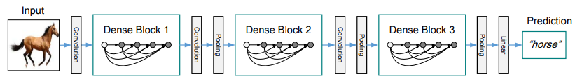
CheXNet (DenseNet-121)
“CheXNet is a 121-layer Dense Convolutional Network (DenseNet) (Huang et al., 2016) trained on the ChestX-ray 14 dataset. DenseNets improve flow of information and gradients through the network, making the optimization of very deep networks tractable.”
Improves feature re-use, information retention, and efficiency.

Slide 23
How do you train a DL Model?
First you need to specify some “hyperparameters”.
Learning rate – How fast the model learns.
Number of epochs – How long the model will train for.
Dropout – If you want to prevent your model from hyper-focusing on unimportant niche details.
Many, many more.
Once set, you get to the actual learning of the model.

Slide 24
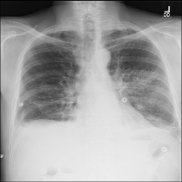
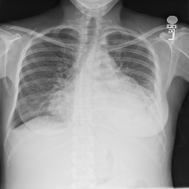
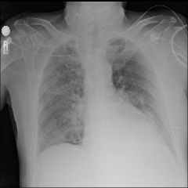
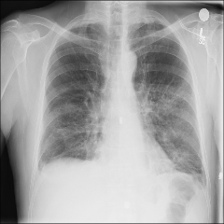
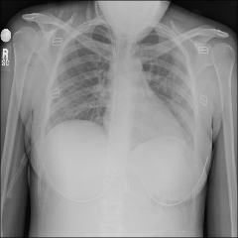
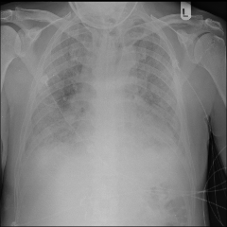
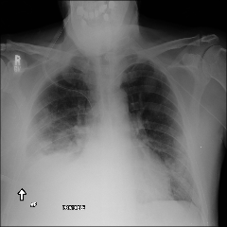
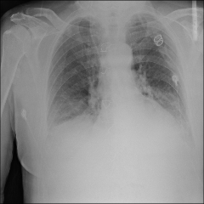
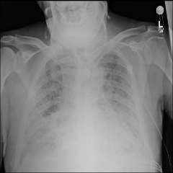
How do you train a DL model?
Training
Validation
Full Dataset (ChestX-Ray14)
Testing

Slide 25
How do you train a DL model?
Training
ChexNet
Validation
Testing

Slide 26
How do you train a DL model?
Training
ChexNet
Validation
Testing

Slide 27
How do you train a DL model?
Training
ChexNet
Validation
Predicted Probability Pneumonia
0.5
0.5
0.5
0.5
Testing

Slide 28
How do you train a DL model?
Training
ChexNet
Validation
Predicted Probability Pneumonia
0.5
0.5
0.5
0.5
Actual Pneumonia Status
Yes
No
Yes
No
Testing

Slide 29
How do you train a DL model?
Training
ChexNet
Validation
Predicted Probability Pneumonia
0.5
0.5
0.5
0.5
Actual Pneumonia Status
Yes
No
Yes
No
Loss
Testing

Slide 30
How do you train a DL model?
Training
ChexNet
Validation
Predicted Probability Pneumonia
0.5
0.5
0.5
0.5
Actual Pneumonia Status
Yes
No
Yes
No
Loss
Testing

Slide 31
How do you train a DL model?
Training
ChexNet
Validation
Testing

Slide 32
How do you train a DL model?
Training
ChexNet
Validation
Testing

Slide 33
How do you train a DL model?
Training
ChexNet
Validation
Predicted Probability Pneumonia
0.59
0.51
Testing

Slide 34
How do you train a DL model?
Training
ChexNet
Validation
Predicted Probability Pneumonia
0.59
0.51
Actual Pneumonia Status
Yes
No
Testing

Slide 35
How do you train a DL model?
Training
We’re learning!
ChexNet
Validation
Predicted Probability Pneumonia
0.59
0.51
Actual Pneumonia Status
Yes
No
Testing

Slide 36
How do you train a DL model?
Training
ChexNet
Validation
Testing

Slide 37
How do you train a DL model?
Training
ChexNet
Validation
Predicted Probability Pneumonia
0.61
0.42
0.65
0.37
Testing

Slide 38
How do you train a DL model?
Training
ChexNet
Validation
Predicted Probability Pneumonia
0.61
0.42
0.65
0.37
Actual Pneumonia Status
Yes
No
Yes
No
Loss
Testing

Slide 39
How do you train a DL model?
Training
ChexNet
Validation
Predicted Probability Pneumonia
0.61
0.42
0.65
0.37
Actual Pneumonia Status
Yes
No
Yes
No
Loss
Testing

Slide 40
How do you train a DL model?
Training
ChexNet
Validation
Testing

Slide 41
How do you train a DL model?
Training
ChexNet
Validation
Testing

Slide 42
How do you train a DL model?
Training
ChexNet
Validation
Predicted Probability Pneumonia
0.59
0.42
Testing

Slide 43
How do you train a DL model?
Training
ChexNet
Validation
Predicted Probability Pneumonia
0.59
0.42
Actual Pneumonia Status
Yes
No
Testing

Slide 44
How do you train a DL model?
Training
We’re still learning!
ChexNet
Validation
Predicted Probability Pneumonia
0.59
0.42
Actual Pneumonia Status
Yes
No
Testing

Slide 45
How do you train a DL model?
Training
ChexNet
Validation
Testing

Slide 46
How do you train a DL model?
Training
ChexNet
Validation
Testing

Slide 47
How do you train a DL model?
Training
ChexNet
Validation
Predicted Probability Pneumonia
0.59
0.42
0.61
Testing

Slide 48
How do you train a DL model?
Training
ChexNet
Validation
Predicted Probability Pneumonia
0.59
0.42
0.61
Actual Pneumonia Status
No
No
Yes
Testing

Slide 49
How do you train a DL model?
Training
Report scores!
ChexNet
Validation
Predicted Probability Pneumonia
0.59
0.42
0.61
Actual Pneumonia Status
No
No
Yes
Testing

Slide 50


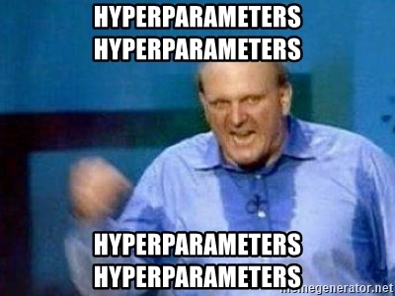


Why do we have a validation set?

Slide 51
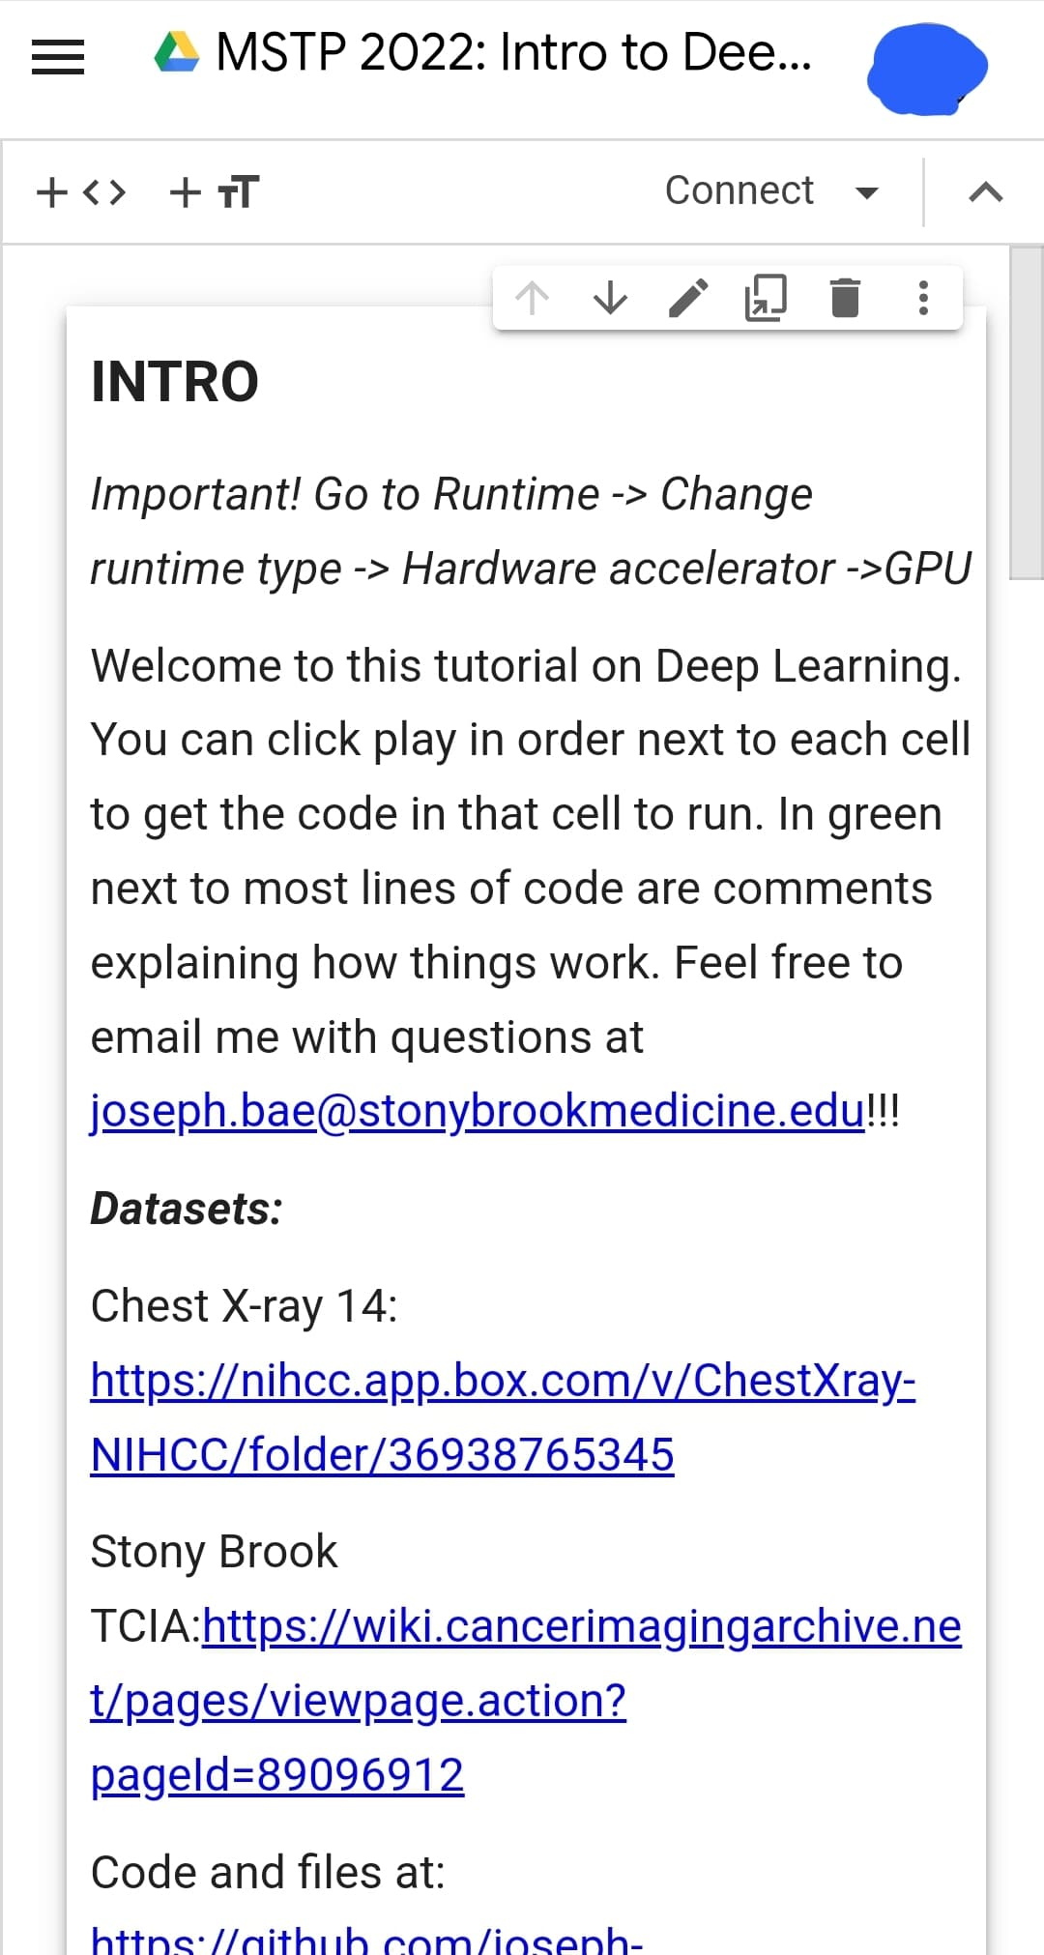
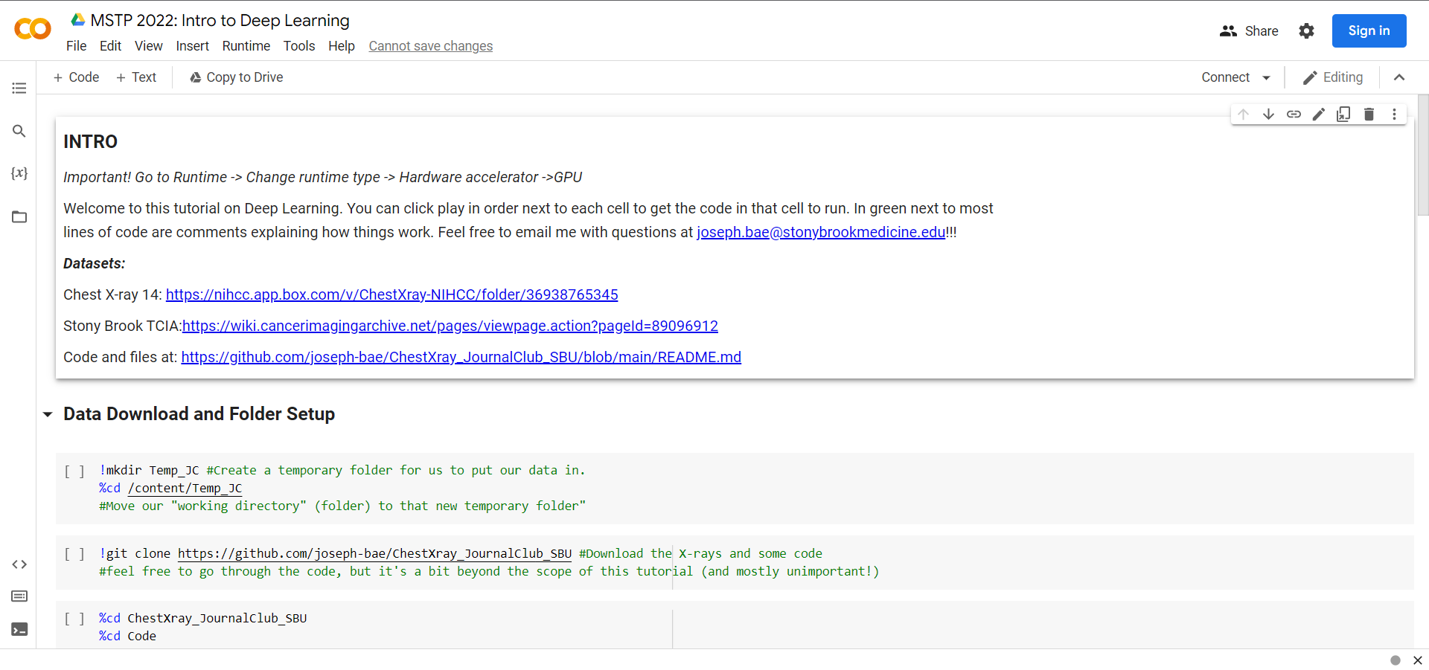
Deep Learning - DEMO
https://bit.ly/378pkAk

Slide 52
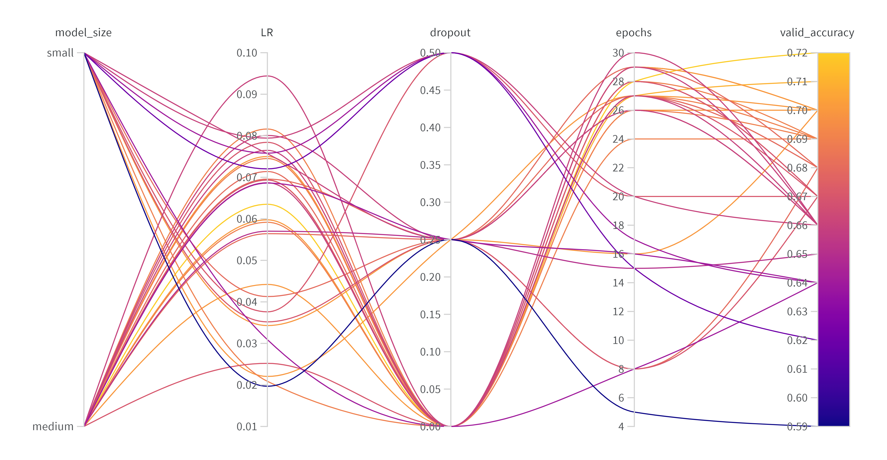
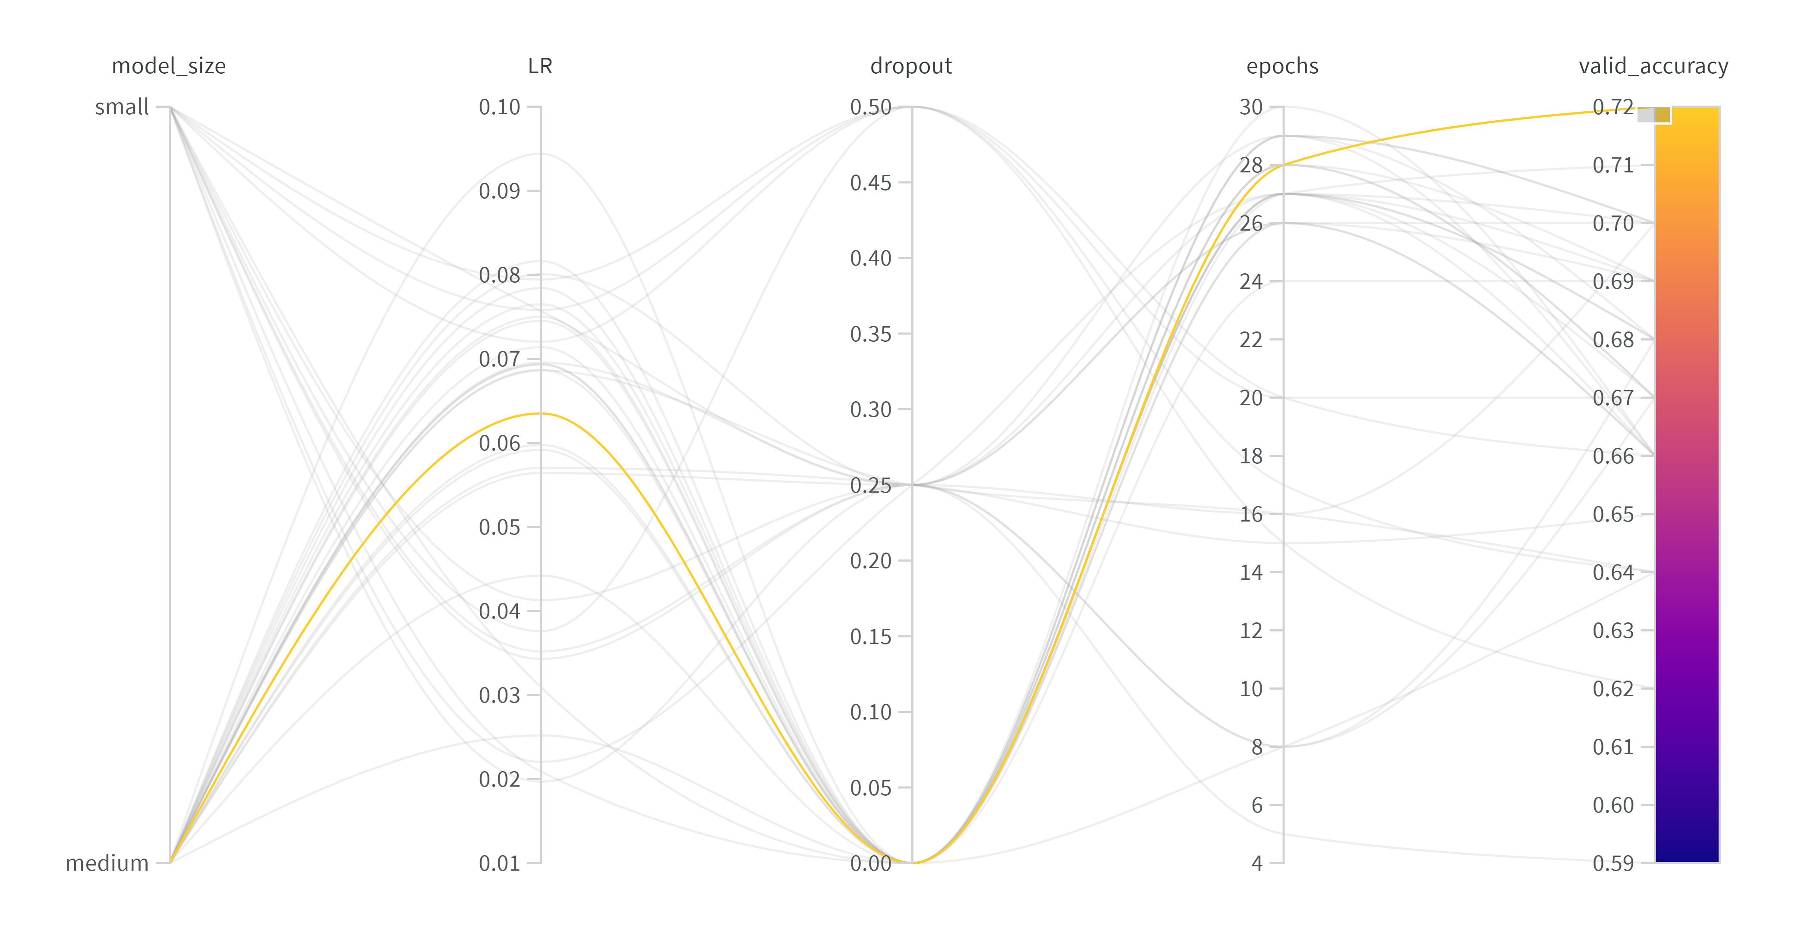
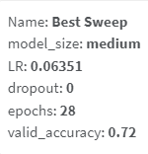
Valid Accuracy
Testing Split Accuracy
ChestXRay-14 Testing Set | 74%
COVID-SBU Testing Set | 63%

Slide 53
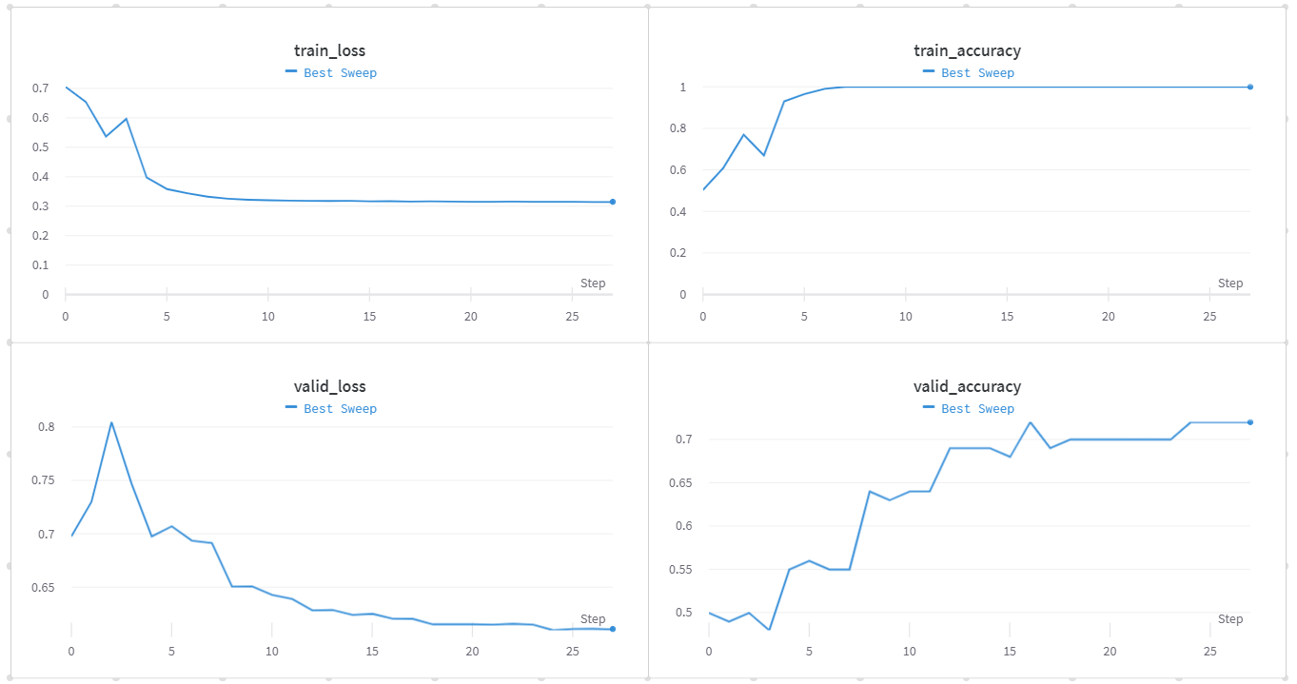

Slide 54
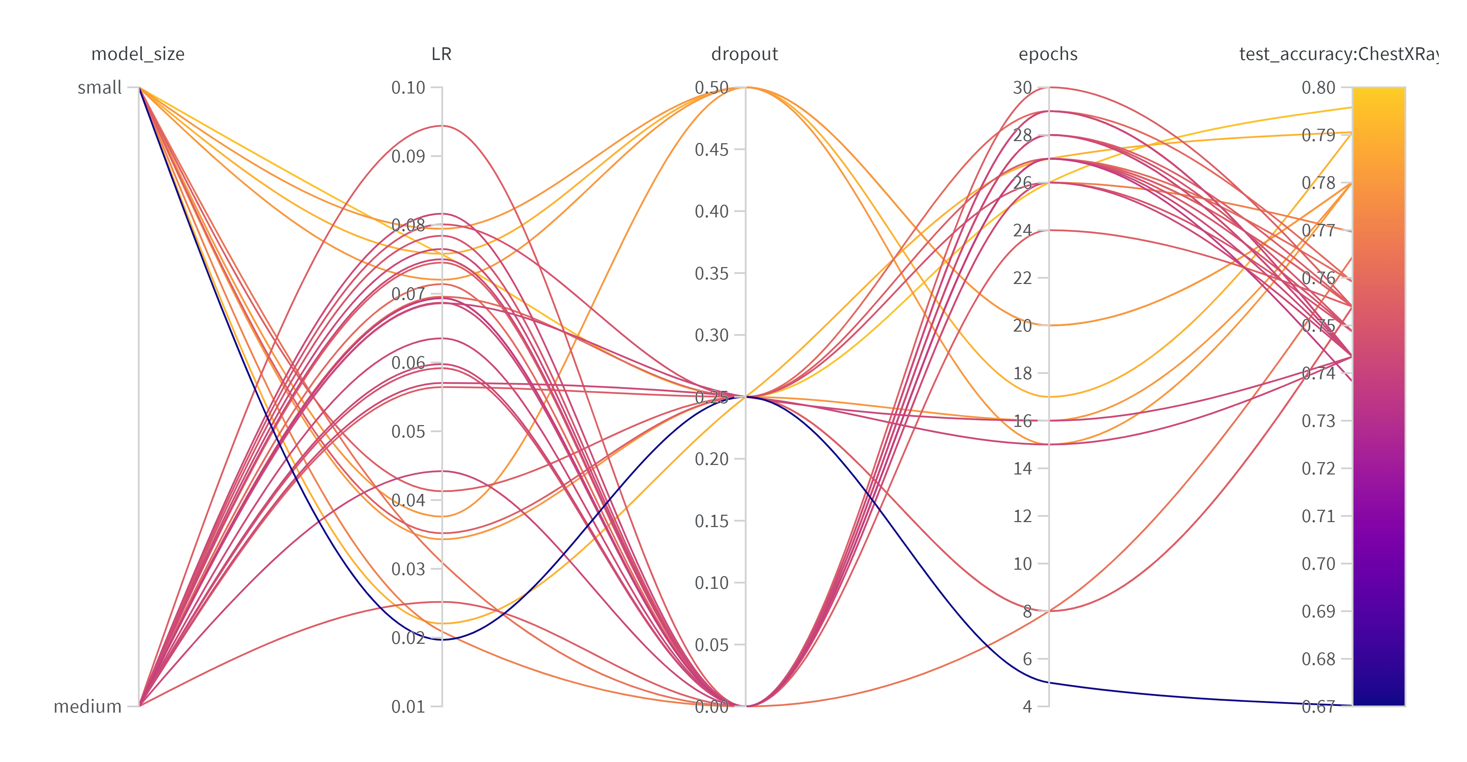
Test Accuracy (ChestXray14)

Slide 55
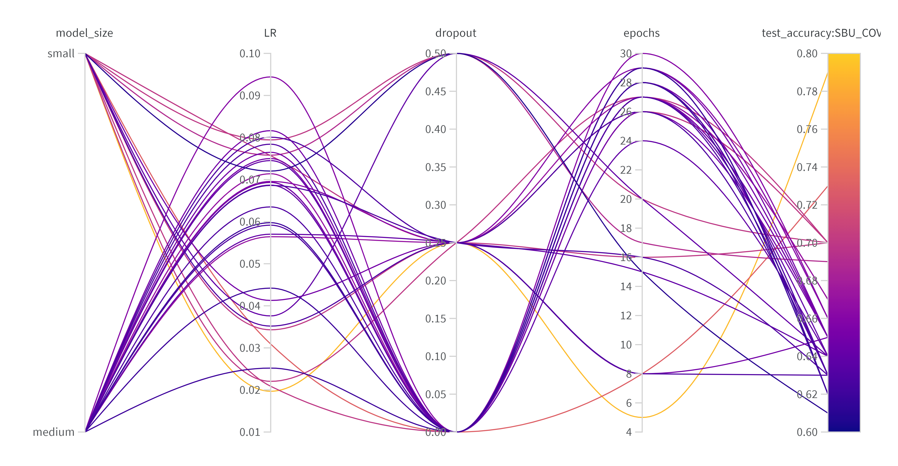
Test Accuracy (COVID-SBU)

Slide 56
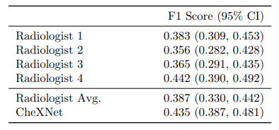
Results
CheXNet obtained state of the art performance in pneumonia detection, outperforming four radiologists (including a thoracic specialist).
Our model was semi-generalizable to COVID data from patients here at Stony Brook (~63% accuracy).

Slide 57
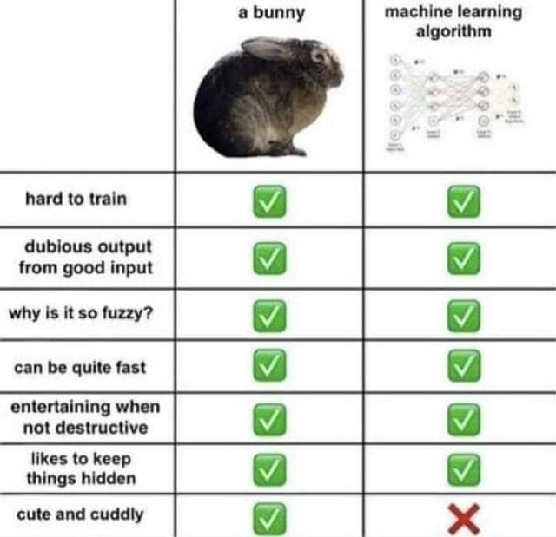
Important Points
CheXNet was not peer reviewed.
Multiple public reviews and correspondences with the authors.
Comparison to radiologists is questionable.
Human medical interpretation relies on other views and medical history.
It’s never clear what a deep learning model is really learning.

Slide 58
Discussion Questions:
Do you buy our results or CheXNet’s? Why or why not?
Is there any use for AI models now in medicine? If so, where and how? If not, what needs to change for them to be used?
Is there anywhere in your field of research that you think Deep Learning could be useful?
Are robots going to take over the world? Why or why not?

